Slide 1
Risk Landscape and Analysis on Chargeback
Presented by Sharon Lu

Slide 2
Table of Contents
01
02
03
04
Problem & Solution
Data Hiccups
Analysis and Target
DTFP, GPV & MCCs
Metrics for Accuracy
VISA Case Analysis
Potential data breach at VISA analysis
Additional Investigation
Data Characteristics
Additional Data Points

Slide 3
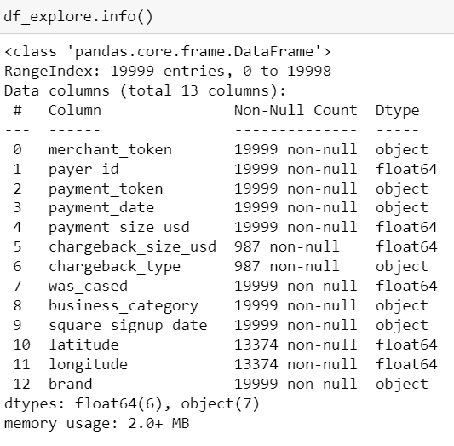
1. Problem and Solution – Data Hiccups Analysis
After running a summary of the dataset, we found that:
19012 values missing in US Dollar portion of the payment that was charged back (chargeback_size_usd) and fraud or non-fraud classification of the chargeback (chargeback_type)
6625 values missing in GPS location of the payment (latitude and longitude)
The causes for missing those values might be:
Operational error: due to merchants or operations team failed to input those four values when logging the transactions
System error: hiccups on merchants or our system due to situations like GPS can’t locate the location or down in internet during transactions
Setup in system excludes non-USD transaction
Chargeback situations fall out of fraud/non-fraud scopes
Significance of the issues:
Out of entire 19999 transaction, we can only analyze 987 transactions on chargeback fraud analysis and it’s under sample

Slide 4
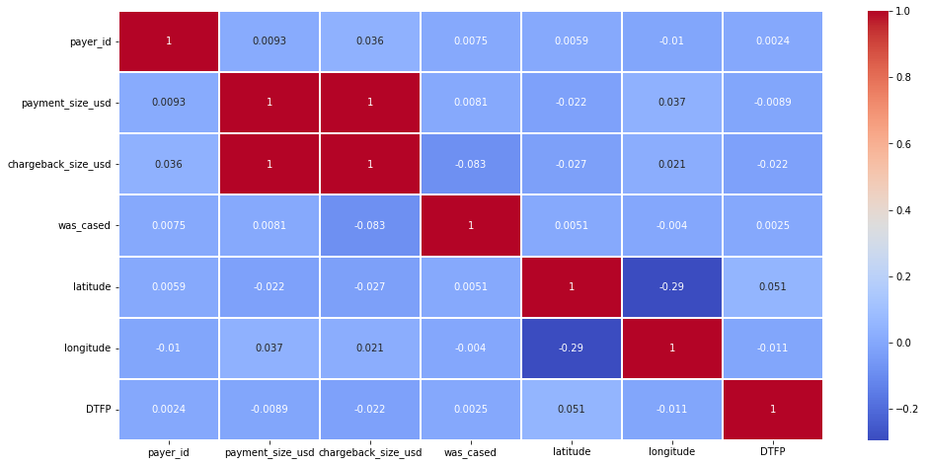
2.1 Analysis & Target - Distribution of time to first payment by seller
The mean of distribution time to first payment by seller is 240 days, minimum day is 0 and maximum day is 735 days.
According to the Heatmap:
the larger the payment size and chargeback size, the longer the distribution time;
if there’s manual review by Risk Operation Team, the longer the distribution time

Slide 5
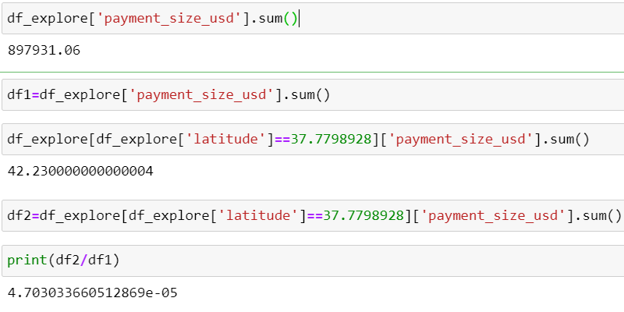
2.2 Analysis & Target - GPV comes from sellers located in San Francisco
The GPV comes from sellers located in San Francisco is of limit volume, only 4.703033660512869e-05

Slide 6
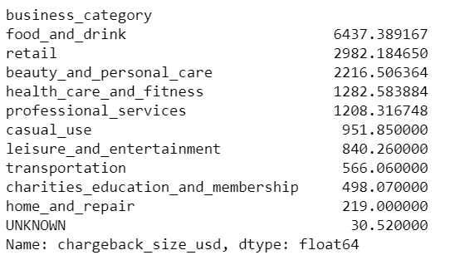
2.3 Analysis & Target - Top three MCCs by fraud chargeback rate (calculated using dollars)
We can see that top 3 MCCs are food and drink, following by retail and beauty and personal care.
The reasons might be those are related to daily consumption and necessity; and each transaction is small. Therefore it’s more vulnerable to fraud chargeback

Slide 7
2.4 Analysis & Target - Metric to gauge the accuracy of our rules/models
Sklearn has a wonderful function called accuracy_score for classification models, which we can use to test how accurate our model is. Essentially this is comparing the predicted values against the actual values in our model.
Our accuracy will change with different values of neighbours. We are going to build a loop to test different how different values of K impact our model. First we will generate 10 random train/test splits for each value of k, and then we will calculate the average accuracy for each value.

Slide 8
3. VISA Case Analysis
At fraud chargeback volume breakdown, Visa cases are more than MasterCard and Amex (47% of total).
At total chargeback volume, Visa cases are also more than MasterCard and Amex (54% of total).
The total higher volume might be the driver for higher fraud chargeback volume.
At individual % of fraud chargeback over total chargeback, total % is 32%, with MasterCard and Amex of 37%, and Visa is only 28%
Conclusions: Visa is actually of lower fraud % but higher chargeback volume which drives up the fraud chargeback volume

Slide 9
4. Additional Investigation
Manual Review Effectiveness by Business Category
Fraud Chargeback % by Category not by dollar amount
01
02
Consumers Behaviors & Fraud Chargeback
03

Slide 10
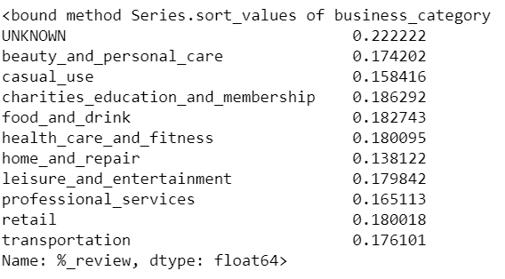
4.1 Manual Review Effectiveness by Business Category
Under fraud cases by business category, we review any cases reviewed by risk operation team to see how’s the effectiveness by business category
Risk Operation Team are very effective in reviewing and identify the beauty and personal care, casual use and charities/educations/membership
Improvement on effectiveness on professional services, retail and transportation

Slide 11
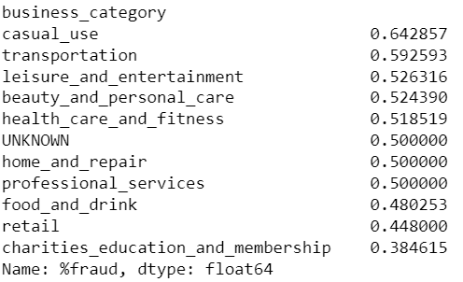
4.2 Fraud Chargeback % by Category not by dollar amount
If review on fraud chargeback % of total chargeback cases instead of by dollar amount:
Casual use, transportation and leisure & entertainment are the top three
Fraud chargeback % is more accurate compared to ranked by dollar amount as it excludes the factor of higher chargeback cases

Slide 12
4.3 Consumer Behaviors & Fraud Chargeback
It would be interesting to understand more on consumer behaviors such as purchasing one-off or multiples times, purchasing with other business category or single purchase, etc. Therefore, we can collect the above data points to see if any correlation between consumer behaviors and the fraud chargeback %.

Slide 13
Thanks!
Do you have any questions?
Sharon_lu@live.com

